Slide 1
TAK Server - Channels

Slide 2
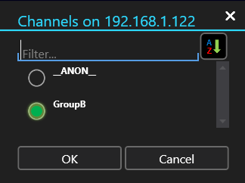

TAK Server - Intro to Channels
Channels allow the user to pick which of their sharing groups are active at a given point in time.
The user’s selection affects all information shared on both the messaging and API ports.
TAK Server admins can migrate from complex setups with many filter groups and a large network footprint, to a consolidated setup with a single messaging and API port.

Slide 3
TAK Server - Channels
Channels build on the existing Certificate Enrollment and x509 Authentication capabilities in TAK.
The CN (Common Name) of the certificate is set to the user’s name, which the x509 Authentication extracts and performs the group lookup using the configured authenticator(File or LDAP).
The groups returned will always provide the authoritative ground truth for the user’s group membership.
This additional step will allow the end user to select a subset of these groups to use for the current authentication request.

Slide 4
TAK Server - Channels Implementation
Channels are disabled by default and needs to be enabled within the core configuration file.
While the TAK Server is running, and you have an open terminal SSH’d into it do the following:
Change directory:
cd /opt/tak
Change to the tak user:
sudo su tak
Edit the CoreConfig.xml file with a text editor:
vi CoreConfig.xml

Slide 5
TAK Server - Channels Implementation
Within the CoreConfig file find the following line:
Add the following to the auth element:
x509useGroupCache=“true”
If done properly it should look like the following:
Note: that if you are using another file service, such as LDAP, the body of the auth element will be different.
Exit the tak user:
exit
Restart the TAK Server
sudo systemctl restart takserver

Slide 6
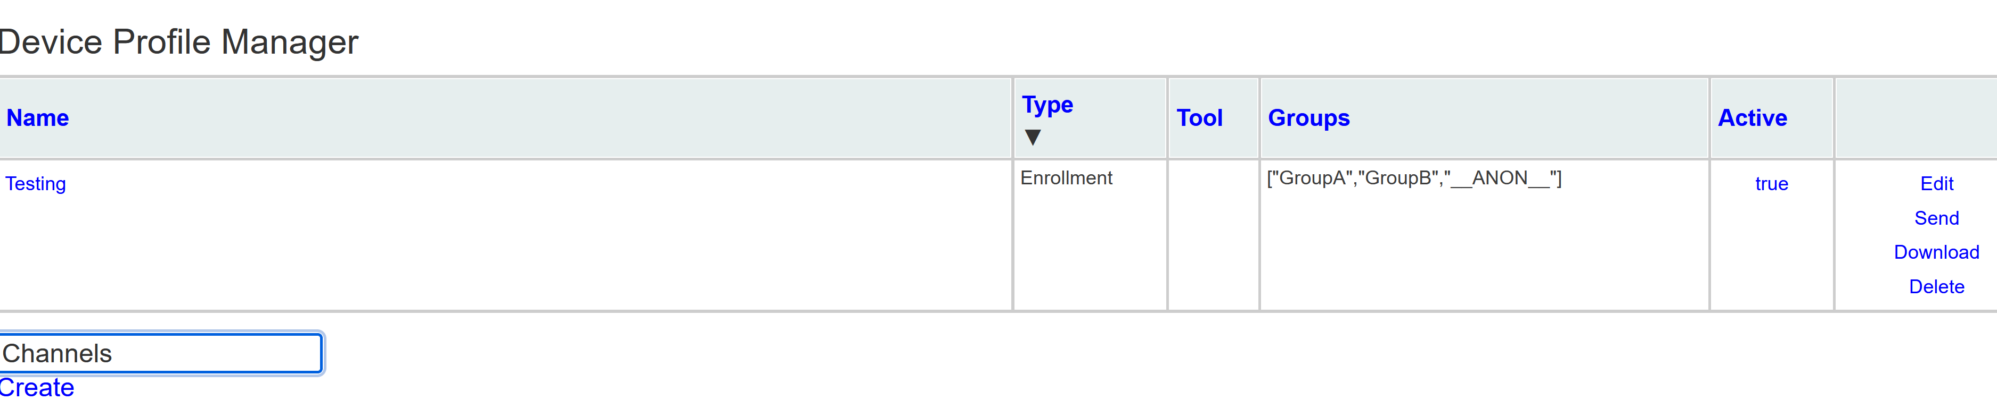
TAK Server - Channels Implementation
To apply the channel configuration to the end-user we need to create a Device Profile, which allows you to upload data packages that can be applied to a device or group.
Go to the Device Profiles section in the admin dashboard:
Hamburger menu → Administrative → Device Profiles
To create a new profile:
Add a name for your profile in the section “Set Profile Name”
Select “Create”

Slide 7
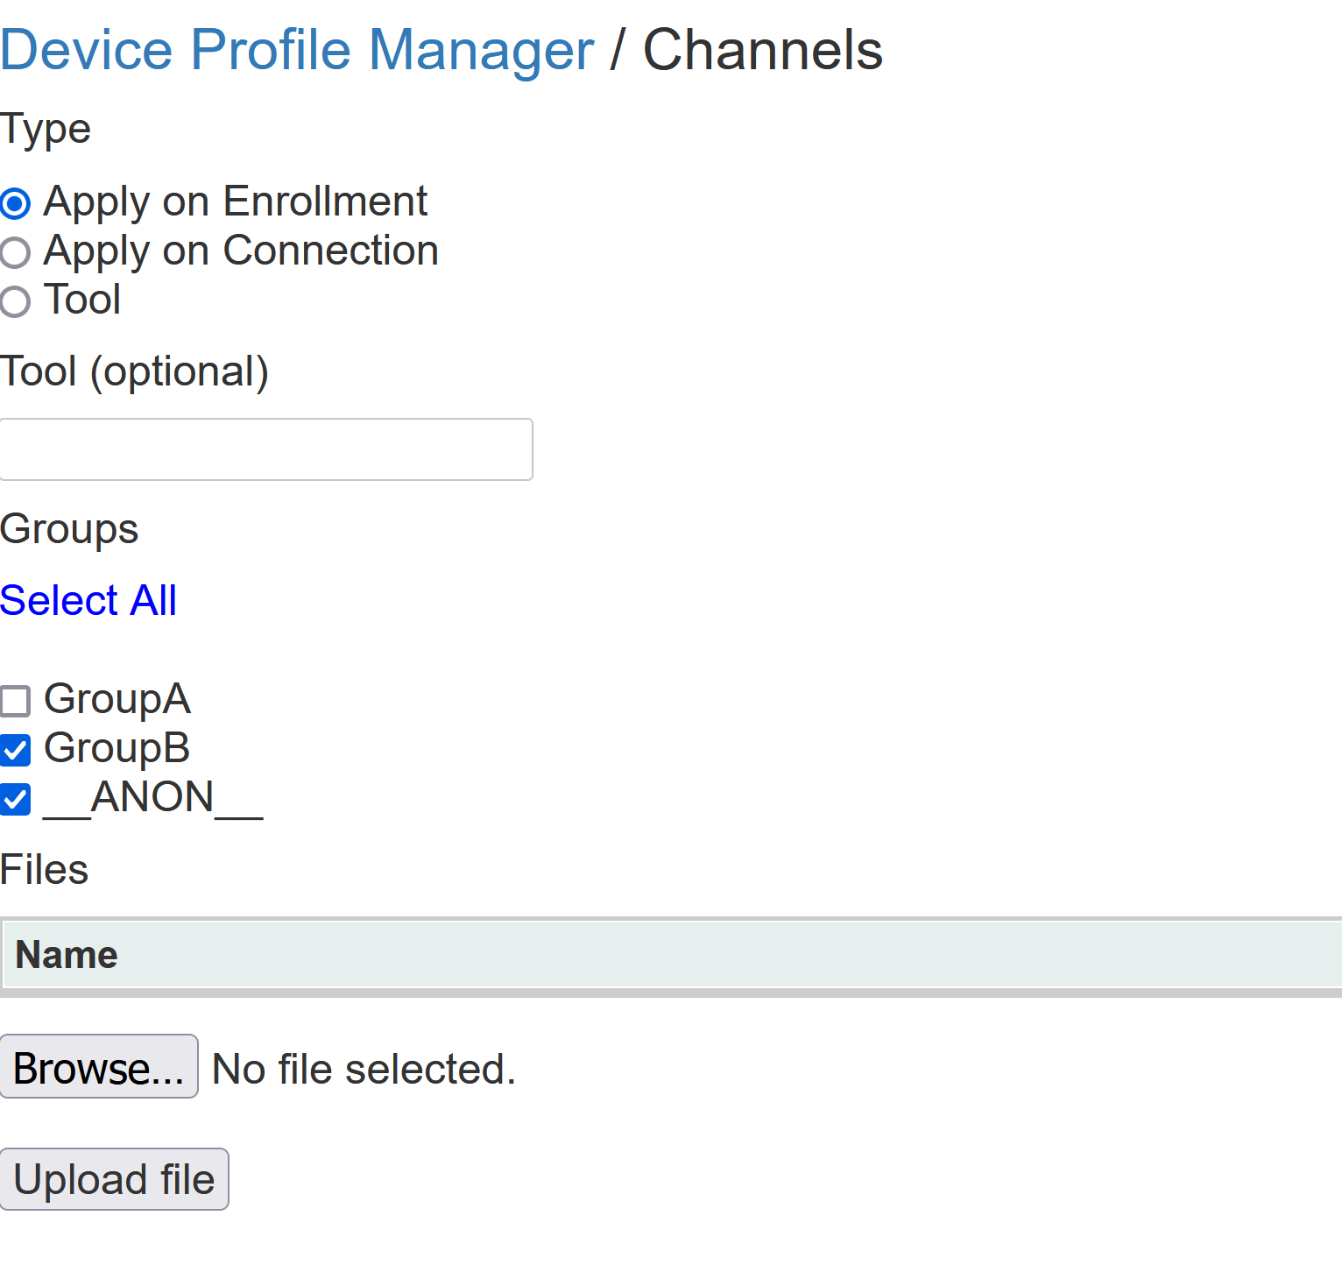
TAK Server - Channels Implementation
Download the following Channel Configuration data package file:
https://mytecknet.com/content/files/2023/08/channels.zip
Within the new profile select the following:
Type: Apply on Enrollment
Apply on Enrollment: all new clients that connect using certificate auto-enrollment will have this device profile applied.
Apply on Connection : all clients that connect will have the device profile applied even if the client has already connected.
Groups: You can select which groups it applied to or use the “Select All” option.
Browse: Select the channel file you downloaded.
Select “Upload File”

Slide 8
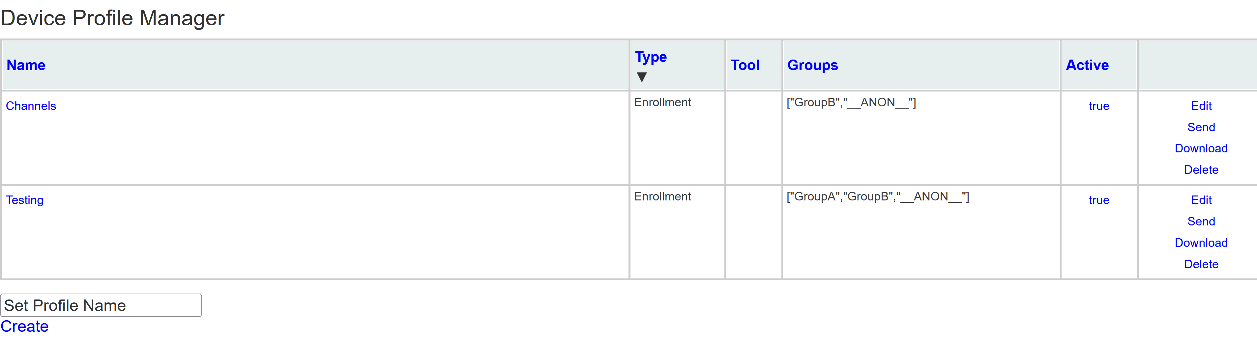
TAK Server - Channels Implementation
When you are done, select the “Device Profile Manager” parent directory to be taken back to the Device Profiles section.
From here you can view and manage your profiles:
You have a couple options for the profiles to edit, send, download, or delete them.
One option to note is the “Send” option which allows you to send the device profile to a specific user.

Slide 9
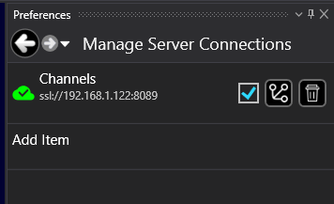
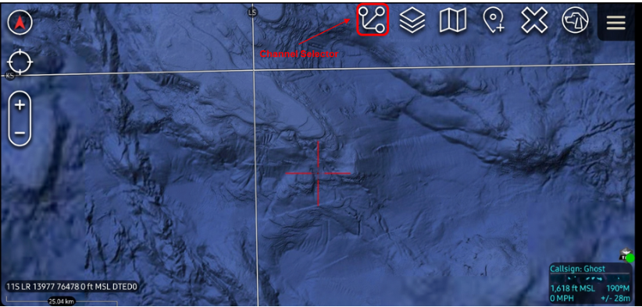
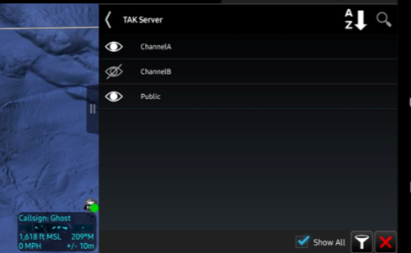
TAK Server - Channels Integration
Once connected to the TAK Server the user can select which groups to enable by selecting the following icon from the “Manage Server Connections” section:
WinTAK
ATAK

